Slide 1
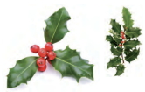
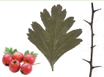
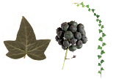
Holly (Native)
Food | Berries are a vital food source of food for birds in winter, and small mammals, such as wood mice and dormice.
Flowers | Flowers provide nectar and pollen for bees and other pollinating insects. Holly blue butterfly eat the flower buds.
Tasty Leaves | Leaves are eaten by caterpillar moths. Smooth leaves are a winter food source for deer.
Places to live | Dense cover and good nesting opportunities for birds. Deep, dry leaf litter may be used by hedgehogs and small mammals for hibernation.
Hawthorn (Native)
Food | Food source for many small birds and insects, including thrushes, hawthorn shield bugs and yellowhammers. Haws are rich in antioxidants and eaten by migrating birds, including redwings, fieldfares and thrushes.
Flowers | Flowers are eaten by dormice and provide nectar and pollen for bees and other pollinating insects.
Tasty Leaves | Hawthorn has one of the highest number of insects on it. Moth caterpillar feed on hawthorn leaves and flies and sawflies feed on shrub leaves.
Places to live | Dense thickets provide shelter for small mammals such as wood mice and are used by birds as nesting sites.
Ivy (Native)
Food | Berries are an essential food source for birds, especially during the winter when there is less food available. The high fat content of the berries is a nutritious food resource for birds including thrushes, blackcaps, wood pigeons and blackbirds.
Flowers | Many rare insects are attracted to ivy flowers, including the golden hoverfly. Nectar and pollen are food for both birds and insects. Flower buds are eaten by Butterfly caterpillars.
Tasty Leaves | The evergreen foliage makes an excellent early nesting site and shelter for birds such as wrens.
Places to live | Ivy provides shelter for many insects through the winter.
© Woodland Trust.
© Woodland Trust. ​
© Woodland Trust. ​

Slide 2
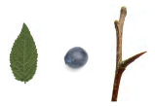
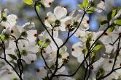
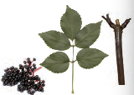
Blackthorn (Native)
Food | Birds feast on the sloe berries in the autumn.
Flowers | Early flowering, blackthorn provide a valuable source of nectar and pollen for bees in spring. Flowers are also used by the black and brown hairstreak butterflies.
Tasty Leaves | Foliage is a food plant for moth caterpillar.
Places to live | Birds nest among the dense, thorny thickets, eat caterpillars and other insects from the leaves.
Dogwood (Native)
Food | Small berry-like fruit serves as a valuable food source for various wildlife species, including birds, squirrels, and deer.
Flowers | Flowers are visited by insects
Tasty Leaves | Leaves are eaten by moth caterpillars. Leaves provide food for the Green Hairstreak Butterfly.
Places to live | Provides areas for shelter and nesting sites for many birds.
Elder (Native)
Food | Small, purple-black, sour berries are eaten by birds and mammals. Small mammals, such as dormice and bank vole eat both the berries and the flowers.
Flowers | Individual flowers are creamy-coloured, highly scented, provide nectar for a variety of insects.
Tasty Leaves | Moth caterpillars feed on the elder foliage.
Places to live | Provides home to several species of moss, lichen and fungi, and shelter for both small mammals and insects.
© Woodland Trust. ​
© Woodland Trust. ​

Slide 3
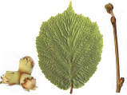
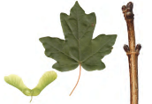
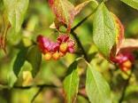
Hazel (Native)
Food | Hazelnuts are eaten by the dormouse, woodpeckers, nuthatches, tits, wood pigeons, jays and small mammals.
Flowers | Hazel flowers provide early pollen as a food for bees.
Tasty Leaves | Hazel leaves provide food for caterpillars of moths.
Places to live | Home to species of butterfly. Shelter for ground-nesting birds such as the nightingale, nightjar, yellowhammer and willow warbler. Home to disturbance-sensitive bryophytes and lichens. Trunk is also home to mosses, liverworts, and fiery milkcap fungus grows in the soil.
Acer (Native) Field-maple
Food | Attractive to aphids and their predators including species of ladybird, hoverfly and birds. Small mammals eat the fruits.
Flowers | Nectar / pollen rich flowers attracting birds, butterflies, moths and other pollinators.
Tasty Leaves | Lots of species of moth feed on its leaves.
Places to live | Shelter and habitat for birds
Spindle (Native)
Food | The bright pink and orange berries hang from its twigs, providing food for mice, birds and even red foxes.
Flowers | The flowers are a rich source of nectar and pollen for insects such as the St Mark’s fly.
Tasty Leaves | Leaves eaten by moth caterpillars. Leaves also attract aphids and their predators including hoverflies, ladybirds and lacewings, as well as house sparrows and other species of birds.
Places to live | Aphids are often found on spindle trees, attracting their predators including ladybirds, lacewings and hoverflies.
© Woodland Trust. ​
© Woodland Trust. ​

Slide 4
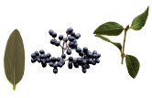
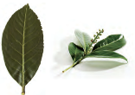
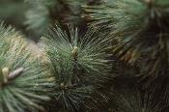
Privet
Food | Main food plant of the privet hawk-moth. Berries are eaten by thrushes and other birds.
Flowers | Flowers provide pollen and nectar for insects when it is in flower.
Tasty Leaves | Leaves are the food source of many moth caterpillars.
Places to live | Provides cover for small birds and other animals. It also provides a habitat for insects.
Laurel (Non-native)
Food | Berries are eaten by several bird species including thrushes and finches. Berries are rich in fats and sugars supporting birds during migration and winter months.
Flowers | Bees, hoverflies, ants and wasps are attracted to the flowers.
Tasty Leaves | Leaves are tough and glossy. They are toxic to insects.
Places to live | Laurel provides cover for birds and small animals and a site for nesting.
Conifer (Non-native)
Food | Berries in the winter provide essential food for birds, such as the common crossbill. Needles. Twigs, bark and seeds in the cones provide food for squirrels.
Flowers
Tasty Leaves | Pine leaves are the main foodplant for the pine hawk-moth. These leaves are also very good at filtering pollution.
Places to live | They help non-migratory birds in cold winters, providing a place for birds to hide from the cold and protection from precipitation. Deer also use coniferous trees as shelter.
© Woodland Trust. ​
© Woodland Trust. ​

Slide 5
__________ (_________)
Food
Flowers
Tasty Leaves
Places to live
__________ (_________)
Food
Flowers
Tasty Leaves
Places to live
__________ (_________)
Food
Flowers
Tasty Leaves
Places to live

